Slide 1
18CSC491 - MINI PROJECT
END-TO-END ETL PIPELINE FOR NYC TAXI DATA WITH DATA QUALITY VALIDATION
Roll No: CB.SC.I5DAS21030
Name : Jagadeesh M
Class : Int M.Sc DAS-A (IV Year)
Sem : VIII (AY 2024- 2025)
1

Slide 2
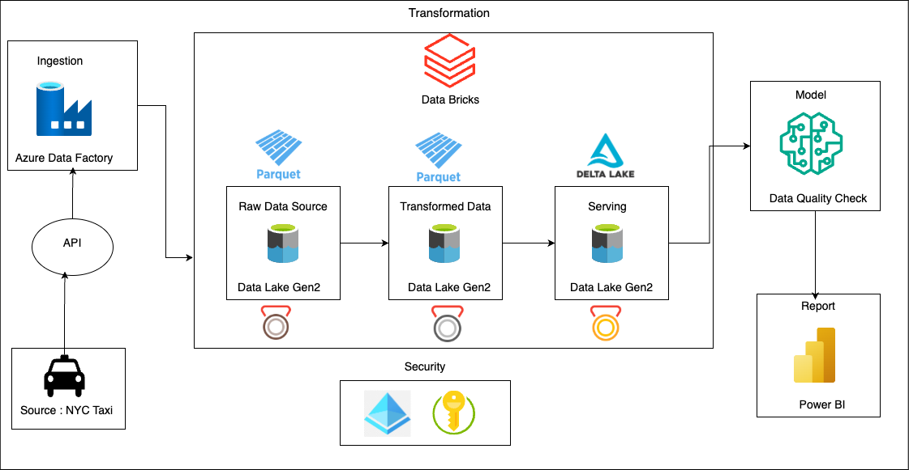
AIM OF THE PROJECT
ARCHITECTURAL DIAGRAM
1. Data Extraction: Azure Data Factory extracts data from the NYC Taxi API.
2. Raw Data Storage: The extracted data is stored in Data Lake Gen2 in Parquet format.
3. Data Processing: Databricks processes and transforms the raw data.
4. Transformed Data Storage: The cleaned data is saved back to Data Lake Gen2 in Parquet format.
5. Security Integration: Azure services like Key Vault ensure secure data handling.
2

Slide 3
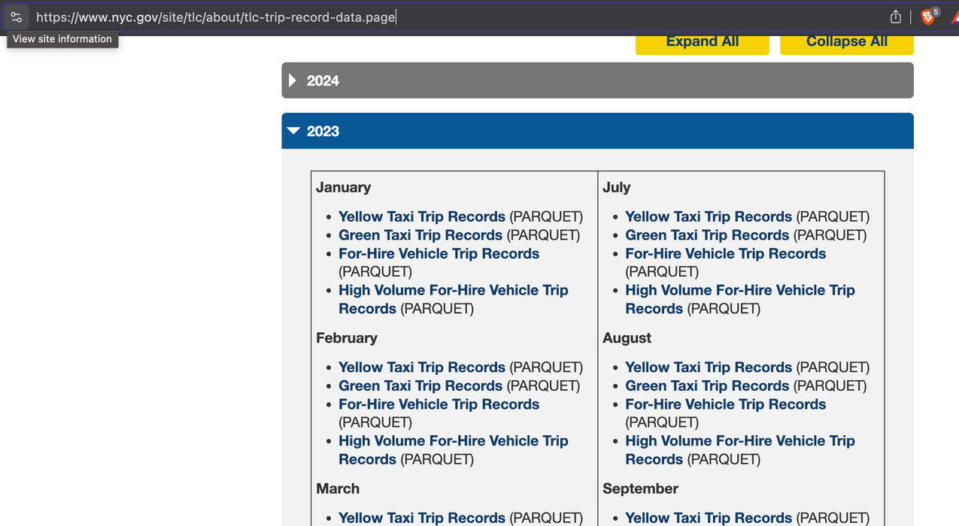
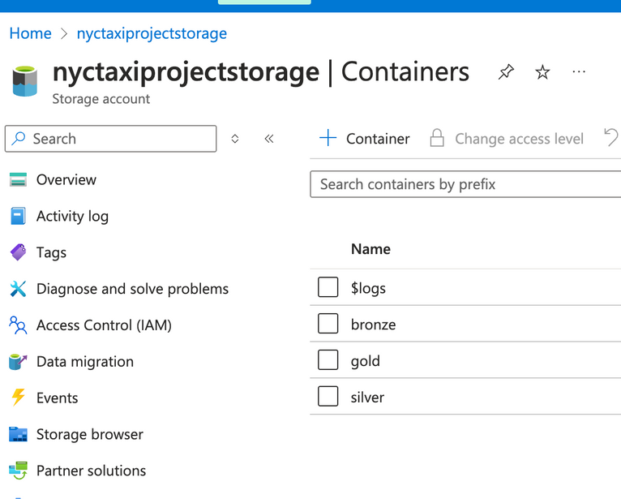
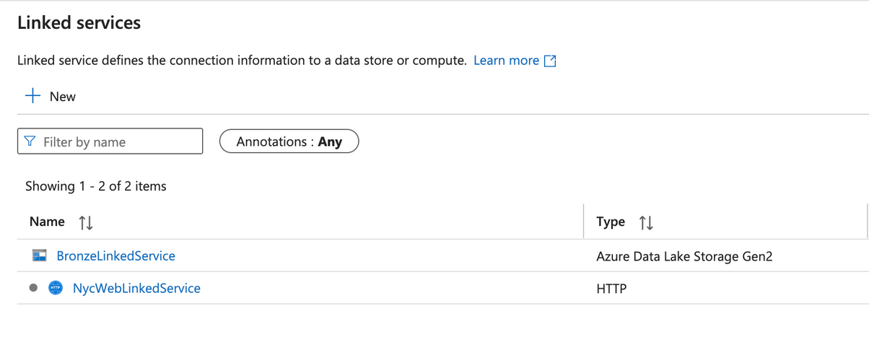
DATA SOURCE TO SINK OVERVIEW
3

Slide 4
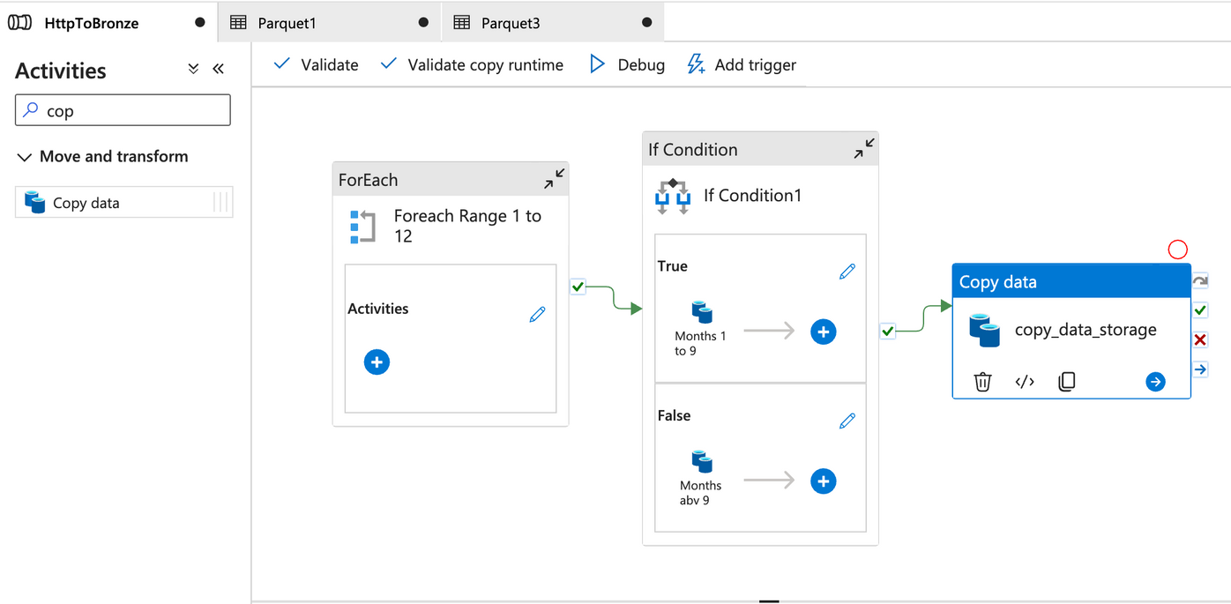
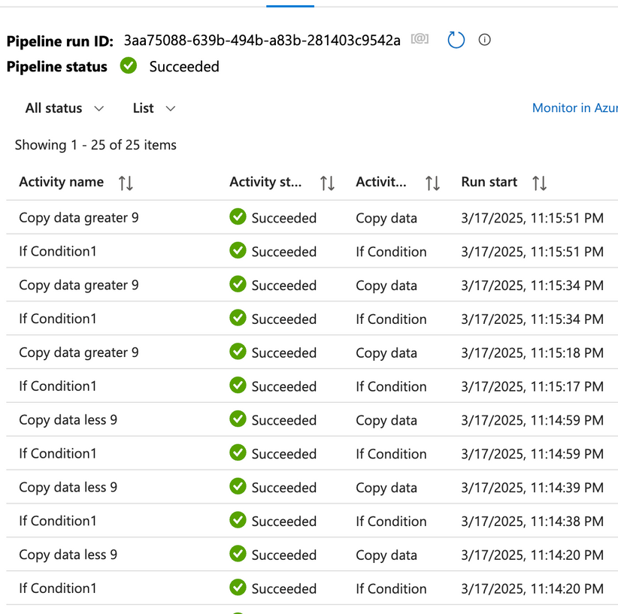
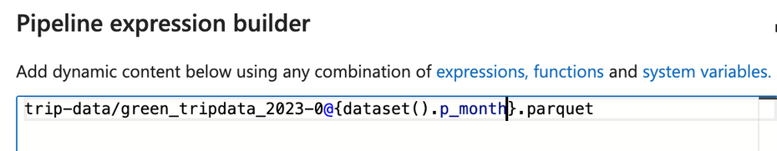
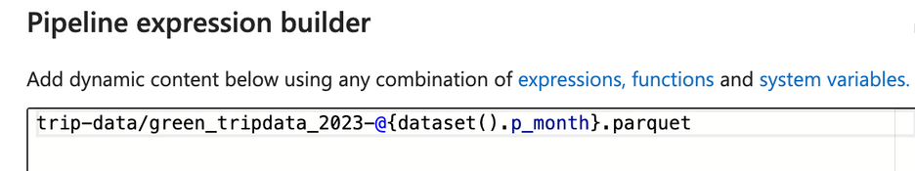
ADF - DATA EXTRACT PIPELINE
4

Slide 5
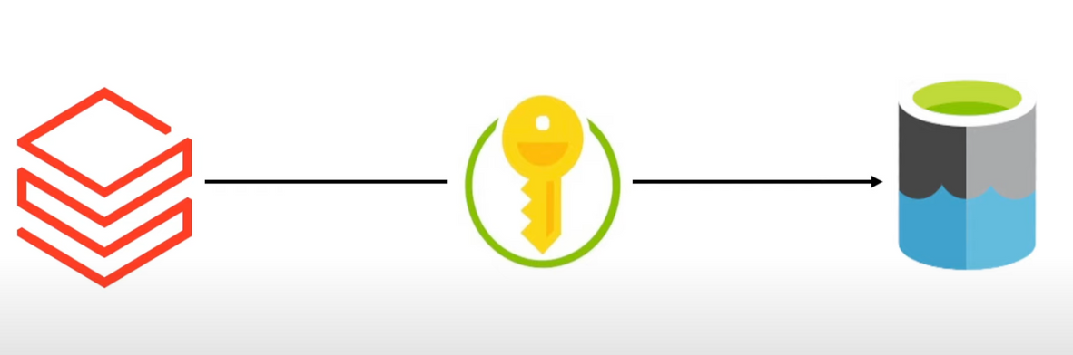
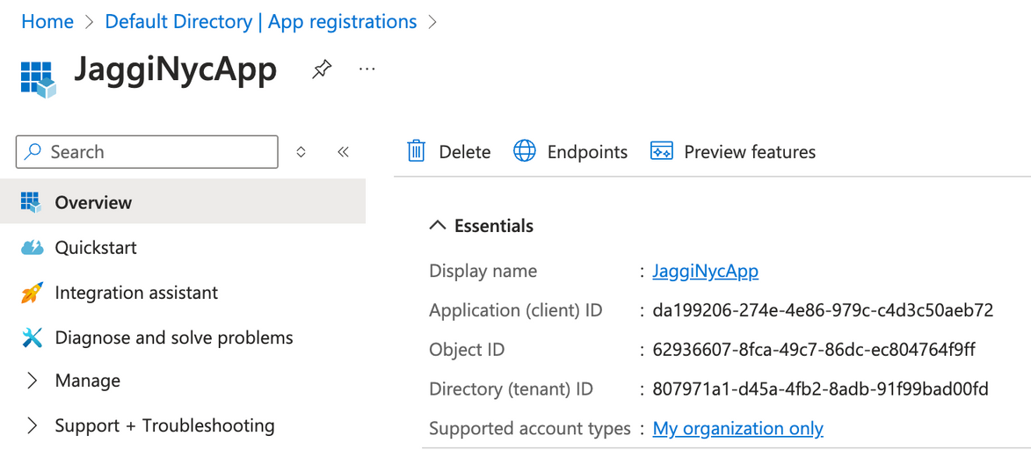
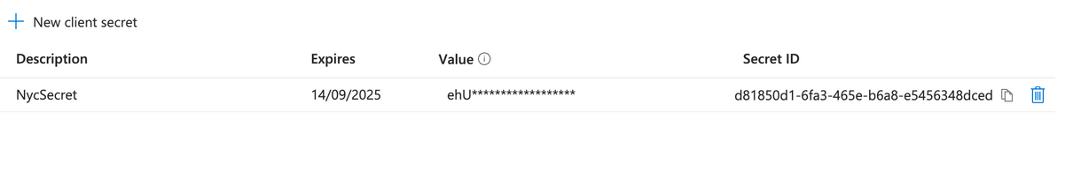
GIVING ACCESS TO DATABRICKS TO CONNECT STORAGE CONTAINERS
1. App Registration: Registered JaggiNycApp in Azure AD.
2. IDs Generated: Obtained Client ID and Tenant ID.
3. Secret Created: Added NycSecret for secure access.
4. Integration: Enables Databricks to connect with Data Lake Storage securely.
5

Slide 6
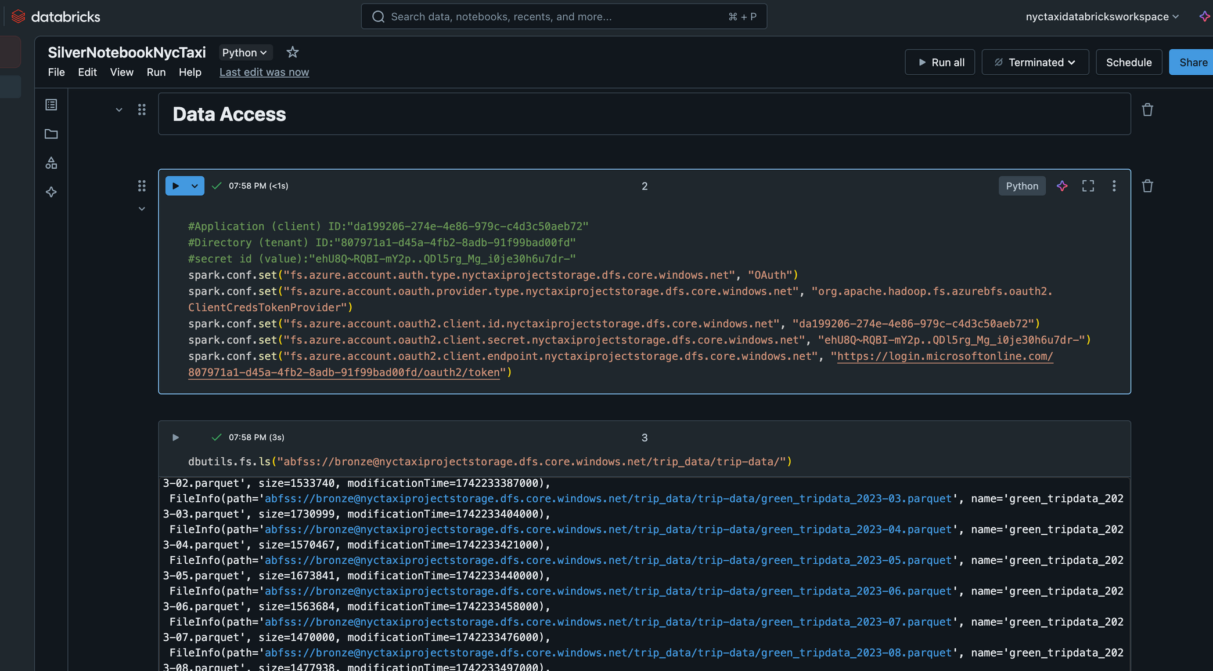
GIVING ACCESS TO DATABRICKS TO CONNECT STORAGE CONTAINERS
6

Slide 7
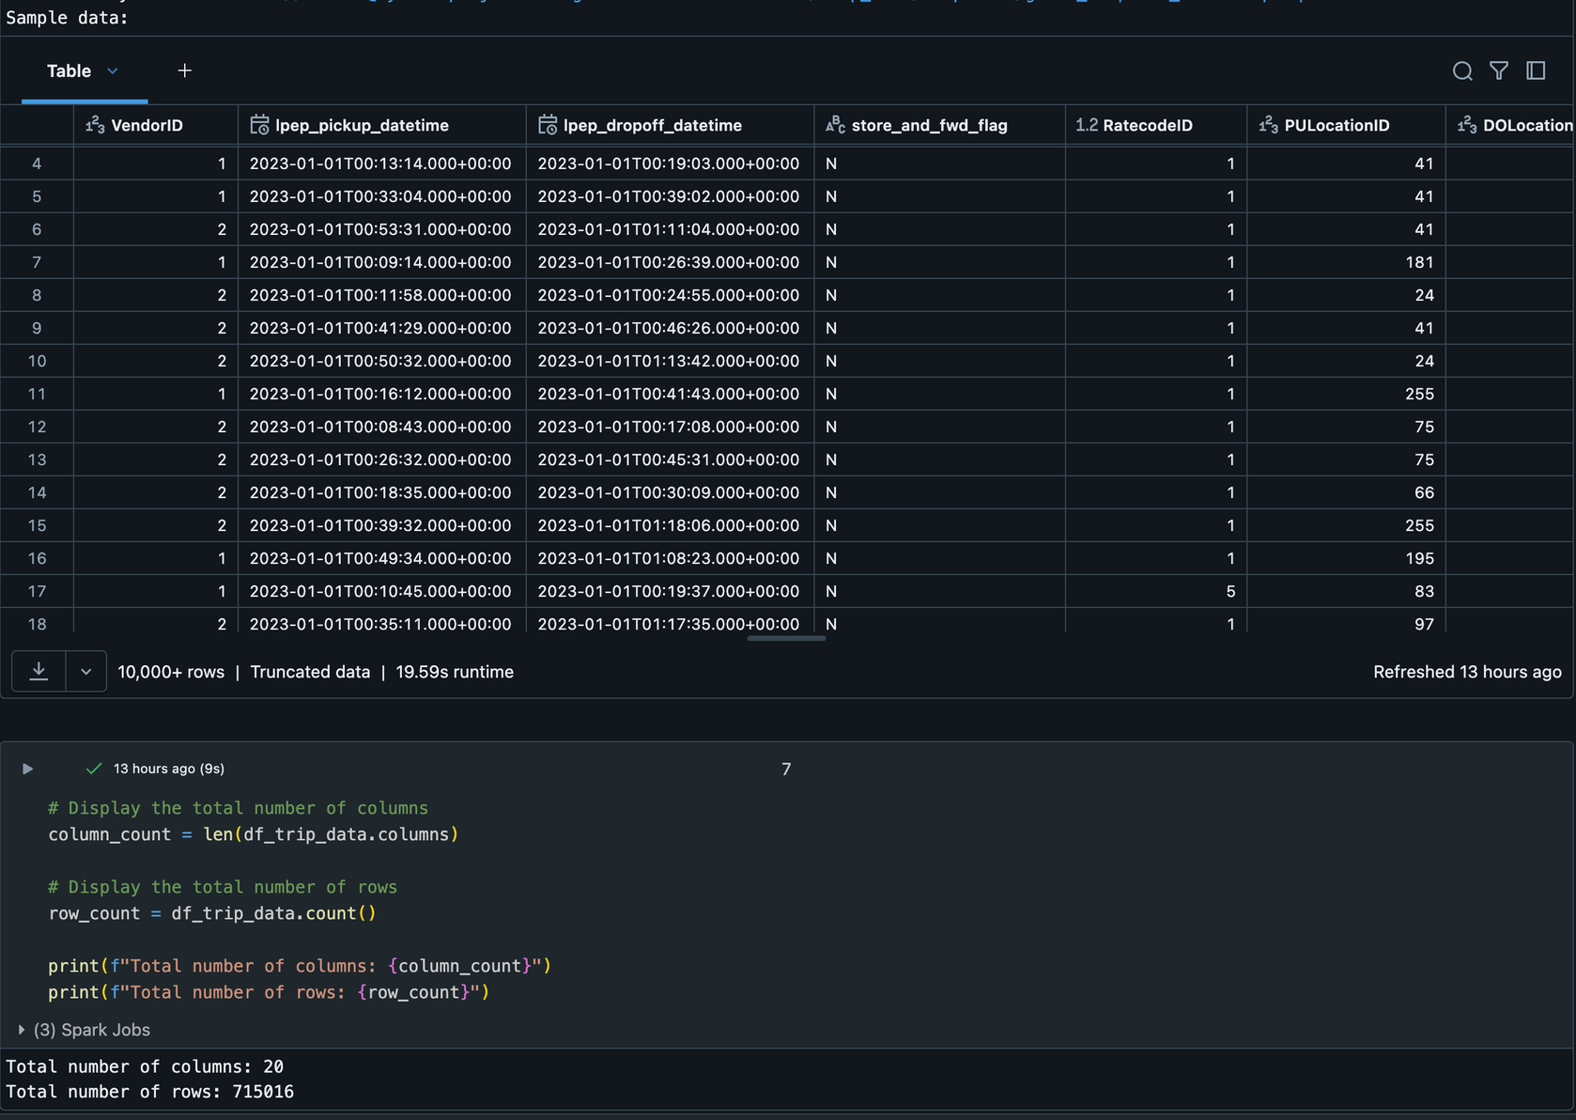
MERGING ALD DATA INTO SINGLE DF AND OVERVIEW
Used .read.format("parquet") with .option("header", True) for schema inference.
Applied .select() with .cast() to ensure consistent data types.
Merged DataFrames using reduce(DataFrame.unionByName, valid_dfs).
Cached the final DataFrame using .cache() for improved performance.
7

Slide 8
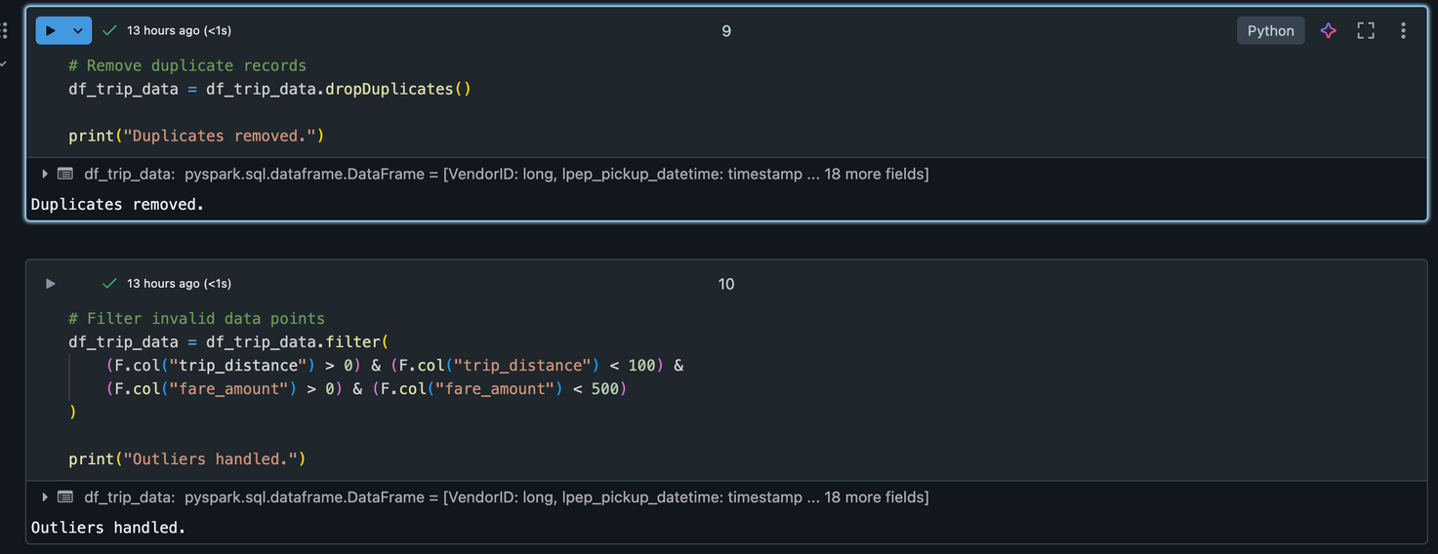
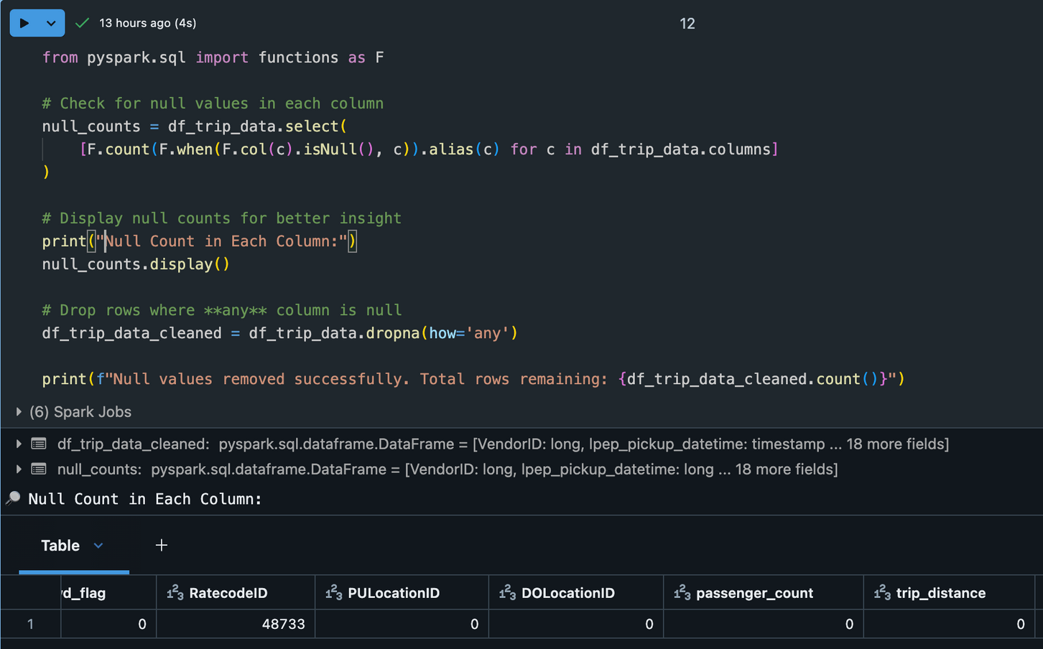
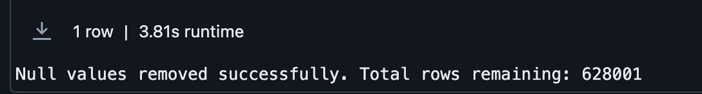
DATA CLEANING AND TRANSFORMATION
• Used .select() with F.count() and F.when() to identify null values.
• Applied `.dropna(how=‘any’) to remove incomplete rows.
• Used .filter() to keep valid trip_distance (0-100) and fare_amount (0-500).
• Used .count() to confirm cleaned data size.
8

Slide 9
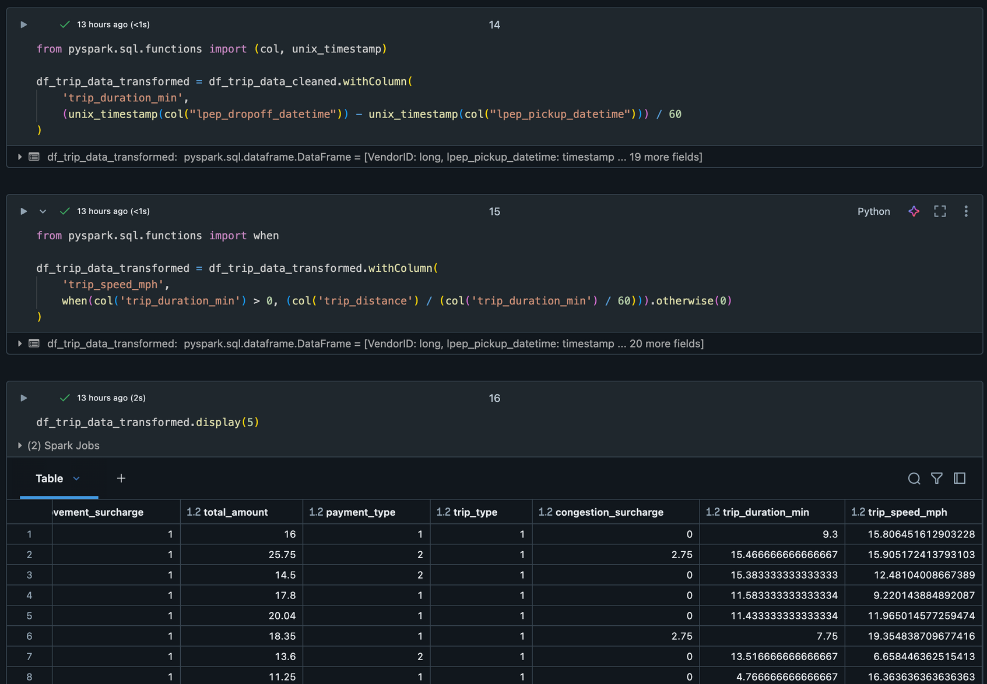
FEATURE ENGINEERING
• Used .withColumn() and unix_timestamp() to calculate trip_duration_min for analyzing trip lengths.
• Applied .withColumn() and when() to compute trip_speed_mph, ensuring valid speed calculations.
• Feature engineering enhances insights by adding meaningful metrics for analysis.
• It improves model performance by providing valuable features for accurate predictions.
9

Slide 10
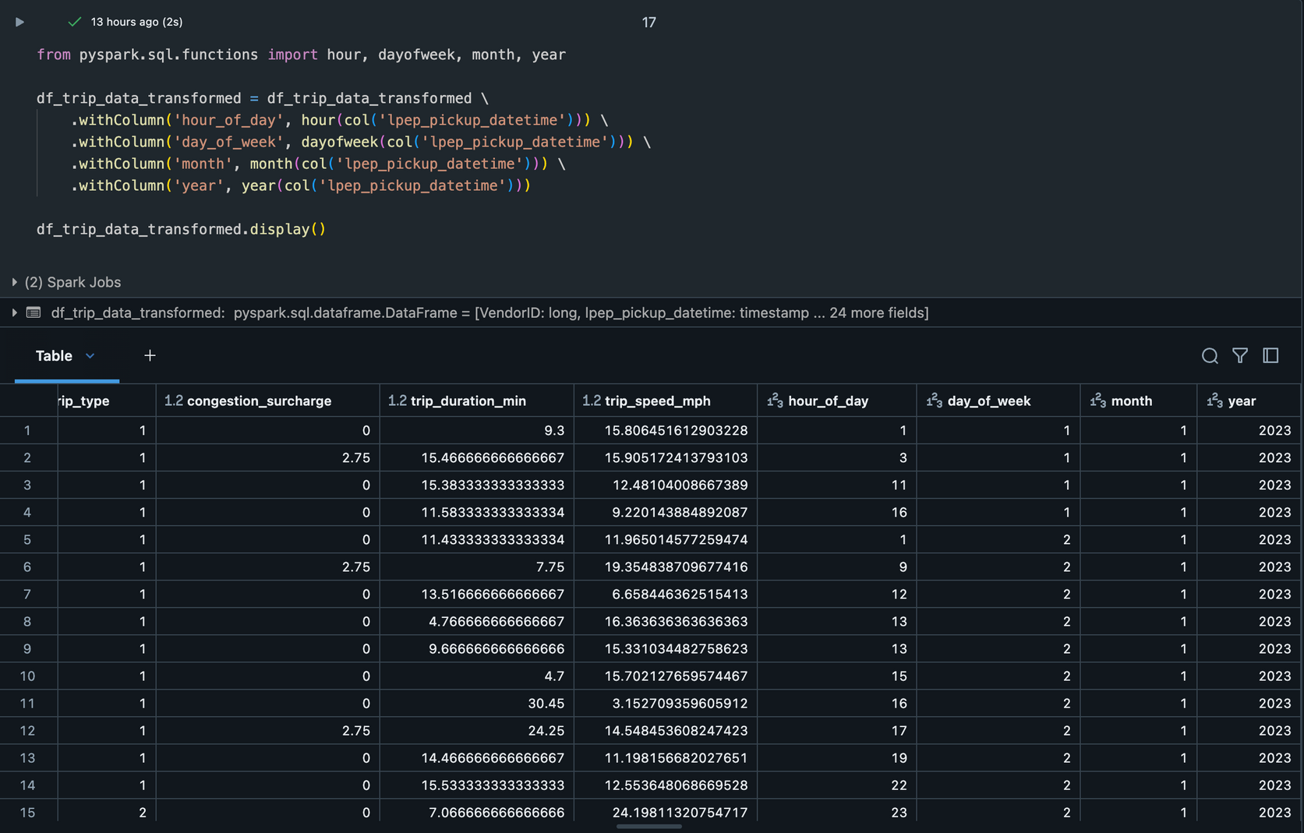
FEATURE ENGINEERING
1. Extracts the hour from lpep_pickup_datetime and creates a new column called hour_of_day.
2. Extracts the day of the week and creates a new column called day_of_week.
3. Extracts the month and creates a new column called month.
4. Extracts the year and creates a new column called year.
5. Displays the updated DataFrame with these new columns.
10

Slide 11
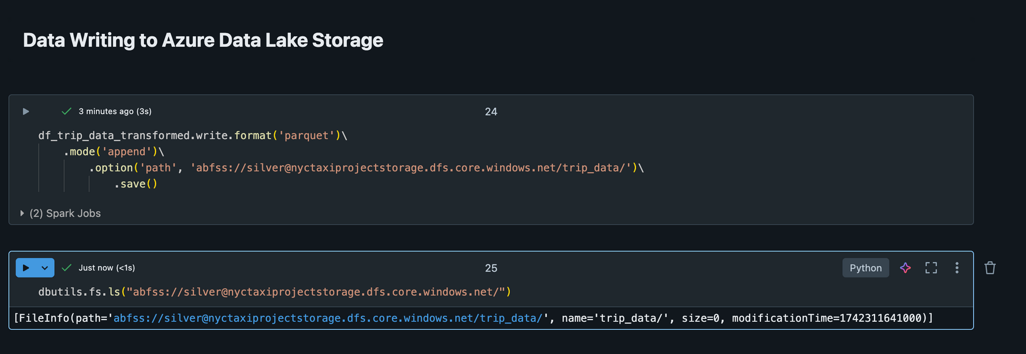
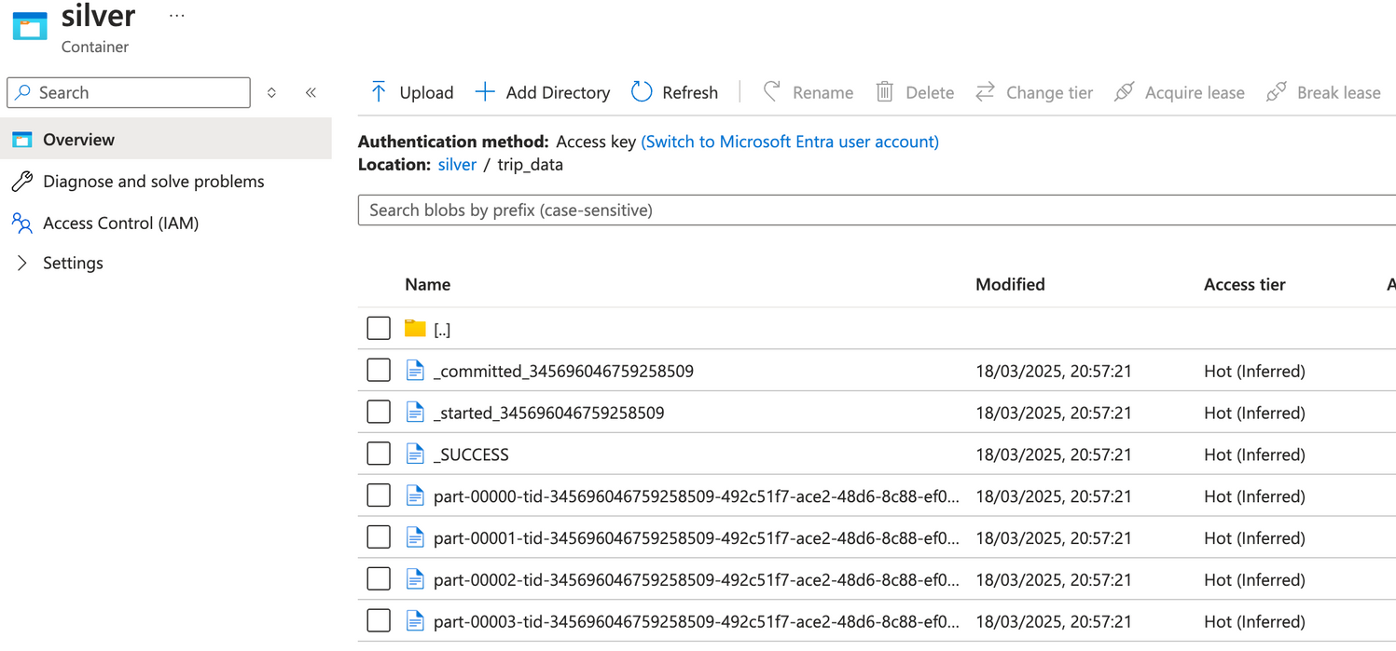
DATA WRITING TO SILVER LAYER (ADLS GEN2)
• Used .write.format('parquet') to save data in efficient Parquet format.
• Applied .mode('append') to add new data without overwriting existing records.
• Specified .option('path', ...) to define the Azure Data Lake Storage (ADLS) location.
• Ensured data moves to the Silver layer for cleaner, structured data.
11

Slide 12
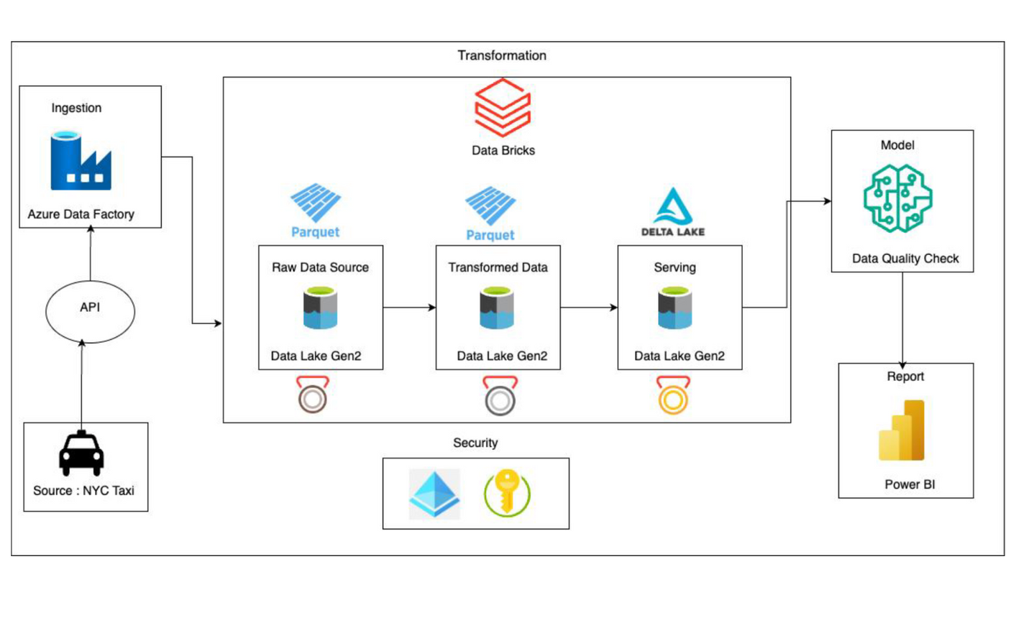
FUTURE WORK OF THE PROJECT
1. Serving Layer: Delta Lake stores clean data with ACID transactions.
2. Autoencoder Model: Learns patterns and detects anomalies.
3. Data Quality Check: Identifies errors and ensures quality.
4. Power BI Reports: Visualizes insights for decisions.
5. Automation: Ensures fast and accurate checks.
6. Outcome: Delivers reliable data for analysis.
12

Slide 13
REFERENCES
Anoshin, Dmitry, Dmitry Foshin, Roman Storchak, and Xenia Ireton. Azure Data Factory Cookbook: Build and manage ETL and ELT pipelines with Microsoft Azure's serverless data integration service. Packt Publishing Ltd, 2020.
Reis, Joe, and Matt Housley. Fundamentals of data engineering. " O'Reilly Media, Inc.", 2022.
13

